Slide 1

Capstone Project - The Battle of Neighborhoods

Slide 2
1st Component
The purpose for this project is to help people who are planning to open a new restaurant in Toronto to chose the idea location with analyzing the data that we generated from our project to get the comfort to find the right location to open the restaurant.
The data we generated from this project is not only for the population and income level for each location, but also for their existing competitors locally.
Introduction where you discuss the business problem and who would be interested in this project

Slide 3
2nd Component
I will combine use the Toronto's 2016-2020 Census data which includes popualtion, income, average income per neighborhood, working-aging, income growth and etc data and fourswaure APR to collect competitors in within the same region.
Data where you describe the data that will be used to solve the problem and the source of the data.

Slide 4
2nd Component
Toronto's Census data is publicly available at this website:
Toronto Neighborhoods' shapefile is publicly available at this website
https://www.toronto.ca/wp-content/uploads/2019/11/99b4-TOHealthCheck_2019Chapter1.pdf
https://mdl.library.utoronto.ca/file-format-geospatial-data/shapefile?page=44

Slide 5
3rd Component
I will be using several methodologies which could be helpful for the investors and entrepreneurs to decide which location is the best for them to open new business.
Methodology section which represents the main component of the report where you discuss and describe any exploratory data analysis that you did, any inferential statistical testing that you performed, if any, and what machine learnings were used and why.

Slide 6
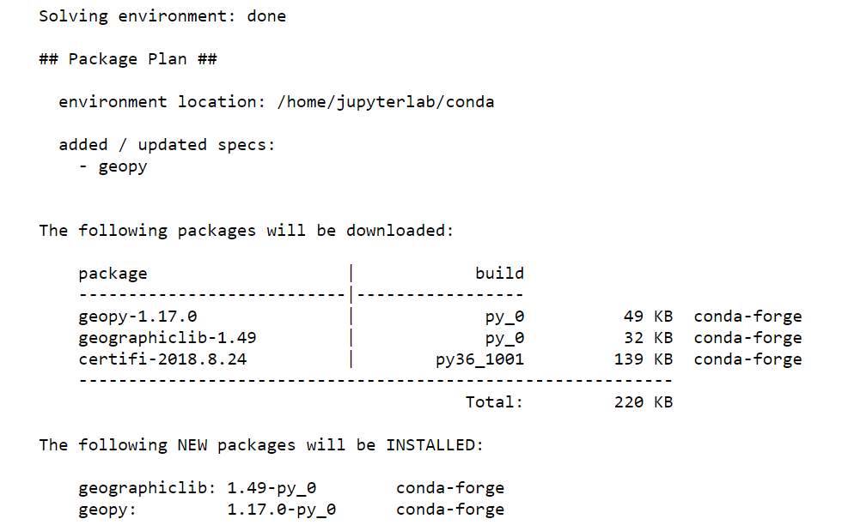
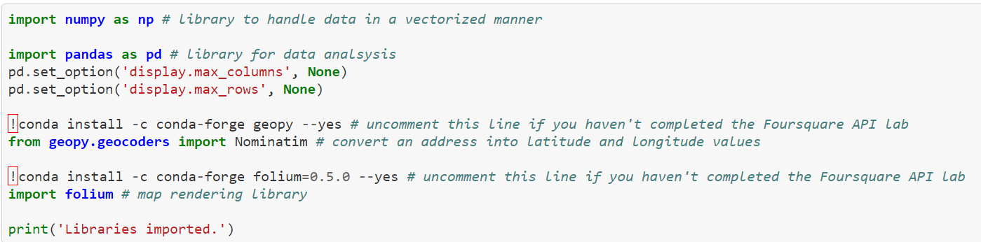
3rd Component
Installed the data resource
All the necessary data source has been downloaded

Slide 7
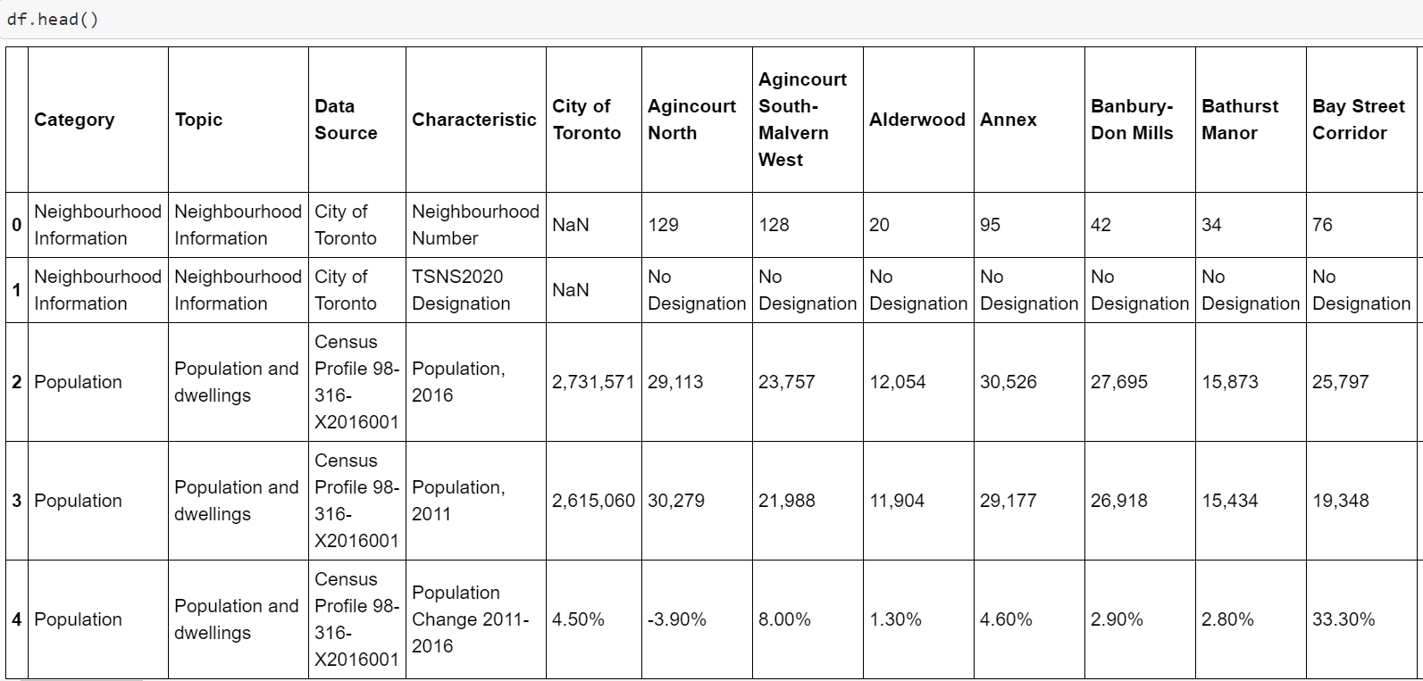
Download and Explore the dataset

Slide 8
3rd Component
Collection Neighborhood information
Populating the Dataset to find the population and income information

Slide 9
4th Component
From the above result, with the information about population and income in that neighborhood, we can locate the area with the highest population and income, that would be the best option for the investor to open the new restaurant. By using this methology, it's easy for us to locate top 3 location which meets those criteria.
Results section where you discuss the results.

Slide 10
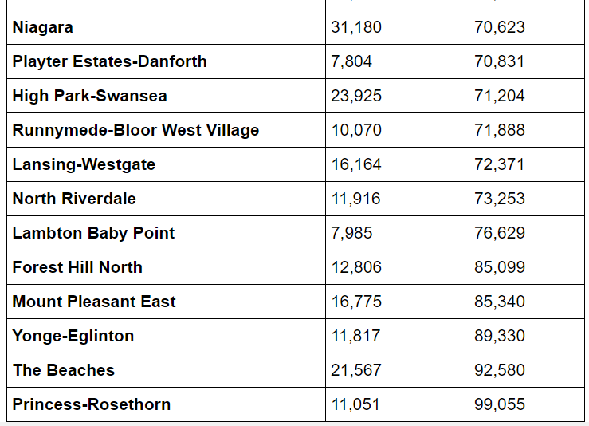
Result – locations with population and income information

Slide 11
^{5th} Component
From the above discussion section which I discussed my observation, I would recommend that the investors choose the below top 3 locations
“The Beaches”, with population of 11,051, and income $99,055,
High park-swansea“, with the population of 23,925 and income $71,204
"Princess-rosethorn”, with the population of 11,051, and income $99,055"
Discussion section where you discuss any observations you noted and any recommendations you can make based on the results.

Slide 12
^{6th} Component
In a conclusion. First, This report is very helpful and trustful for the investors who are interested in finding a good location for them to open the restaurant.
However, the result has the limitation since the data source we generated didn't cover all the aspects/ variables, such as, transpiration, criminal case, car accident case and etc.
Conclusion section where you conclude the report.

